Slide 1
Docker Foundations Recap

Slide 2
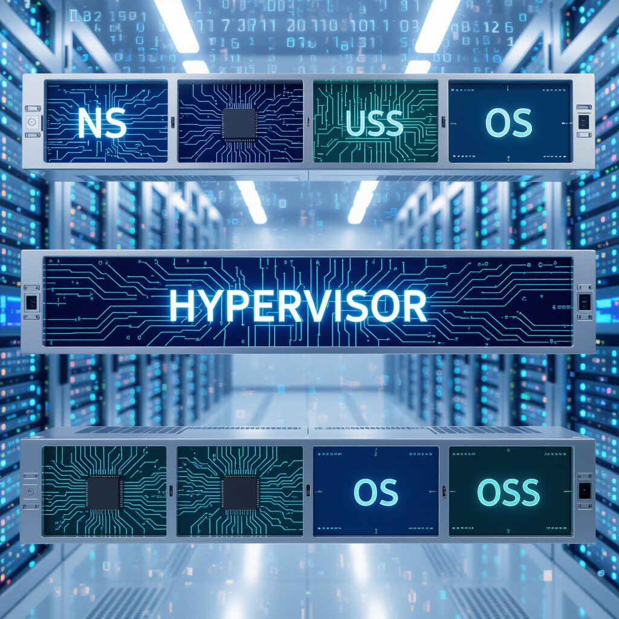
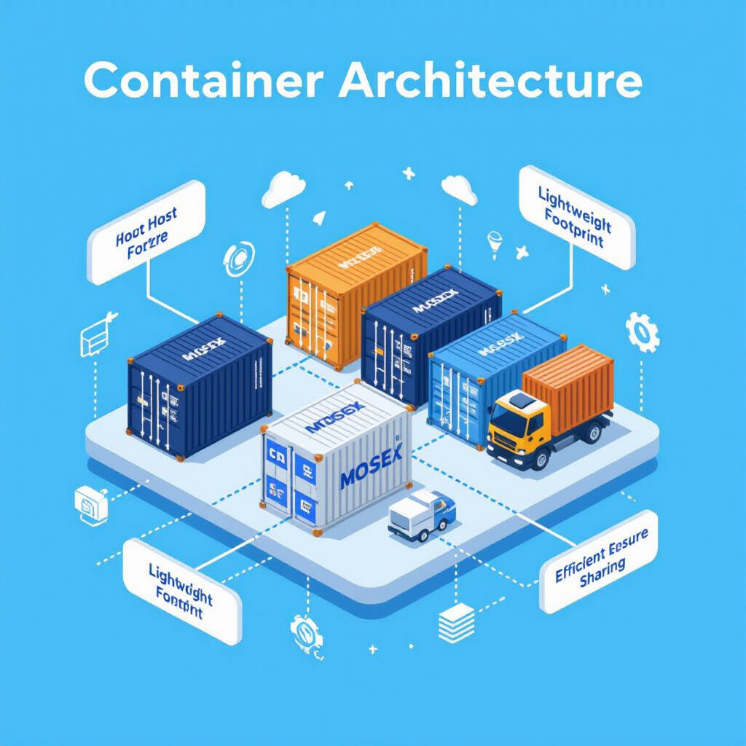
VMs vs Containers
VMs (Virtual Machines)
Containers
VMs emulate an entire hardware stack, including the operating system, which introduces significant overhead and slower performance.
Each VM requires dedicated CPU, memory, and storage, leading to high resource consumption.
While VMs offer strong isolation between environments, this comes at the cost of efficiency and startup speed.
Containers share the host operating system kernel, which eliminates the need for full hardware emulation. This leads to faster startup times and a lightweight footprint.
They consume fewer resources, allowing multiple containers to run efficiently on the same system.
This shared architecture provides high efficiency while maintaining sufficient isolation for most use cases.

Slide 3


Understanding Namespaces and Cgroups
Namespaces
Cgroups
Namespaces isolate system resources like process IDs (PID), network interfaces, and mount points. This ensures each container has its own view of these resources.
By creating separate environments for each container, namespaces provide strong process-level isolation, prevent interference between containers, and enhance system security and stability.
Cgroups manage and limit system resources such as CPU, memory, and I/O for processes. They help enforce resource quotas, improve system stability, and prevent any single process from consuming excessive resources.
Cgroups v2 offers improved control and unified hierarchy, enabling more efficient and secure resource allocation.

Slide 4
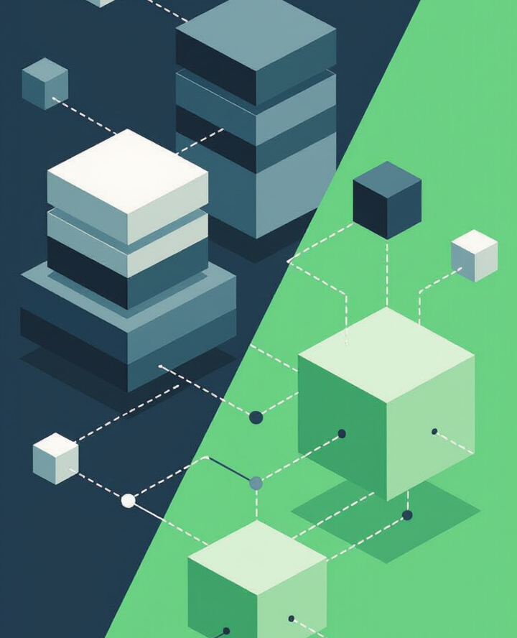
Introduction to Docker
Docker Overview Docker is a containerization platform that bundles applications with all their dependencies, making them easy to run anywhere.
DevOps Role: Streamlines deployment, scaling, and CI/CD workflows.
Problems Solved: Eliminates environment mismatch issues (“works on my machine”), ensuring consistency and portability across systems.

Slide 5

Installing Docker
Docker Installation & Verification
Installation: Docker can be installed on Windows, macOS, or Linux using the official Docker Desktop (Windows/macOS) or Docker Engine (Linux). Follow instructions from https://docs.docker.com/get-docker.
Verification: After installation, open a terminal or command prompt and run: docker run hello-world
This checks that Docker is working by running a test container that prints a confirmation message.

Slide 6

Insights from docker info
Running docker info gives valuable details about your Docker setup, including:
Docker Engine Version – Shows the installed Docker version.
Container & Image Counts – Number of running, paused, stopped containers and total images.
Storage Driver – Type of file system driver used (e.g., overlay2).
Kernel Version – Indicates the OS kernel Docker is running on.
Security Options – Lists enabled features like seccomp, AppArmor, or SELinux.

Slide 7
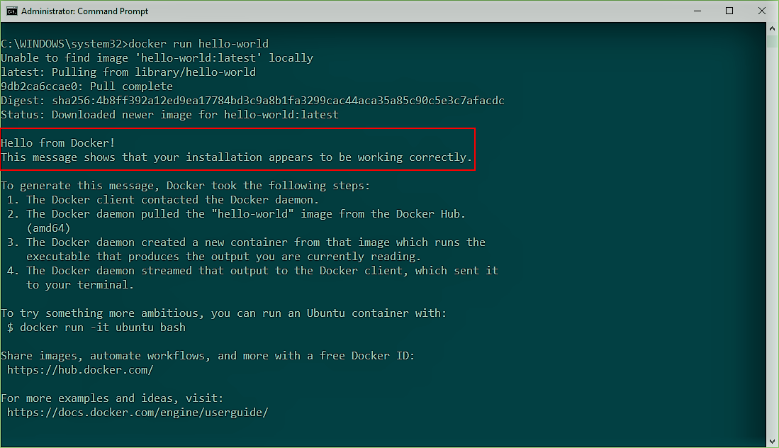
Hello-World Demo
Command:
docker run --name hello-demo --rm -p 8080:80 hello-world
Flags Used
--name: Assigns a name to the container.
-p: Publishes a container’s port(s) to the host.
--rm: Automatically removes the container when it exits.
Process
Docker pulls the hello-world image (if not local).
Creates a new container.
Starts the container, which prints a message.
Container exits and is removed (due to --rm).

Slide 8
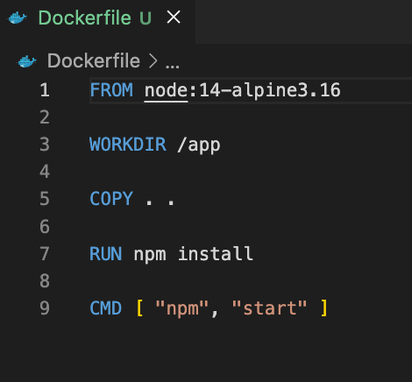
Creating a Basic Dockerfile
Dockerfile Example Explained:
FROM node:14-alpine3.16 Uses a lightweight Node.js 14 image based on Alpine Linux.
WORKDIR /app Sets the working directory inside the container to /app.
COPY . . Copies all files from the current host directory to the container’s /app.
RUN npm install Installs project dependencies.
CMD ["npm", "start"] Runs the app using the npm start

Slide 9
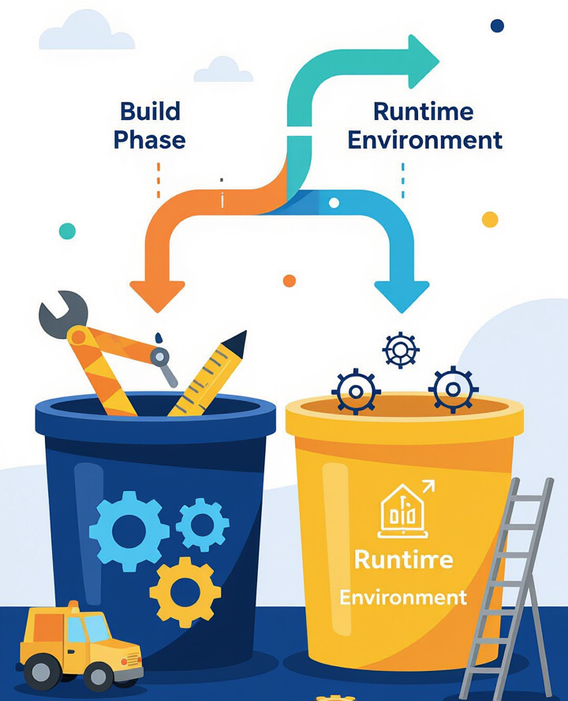
Multi-Stage Builds
Multi-stage builds separate the build process from the final runtime environment, allowing you to create optimized Docker images.
Concept: Use one stage to compile/build the app, and a second stage to run it, keeping only what’s necessary.
Smaller Images: Final images include only runtime dependencies, reducing size significantly.
Improved Security: By excluding build tools and unnecessary files, the image has a smaller attack surface.
Better Maintainability: Clear separation of build and run stages makes it easier to manage and update dependencies.

Slide 10
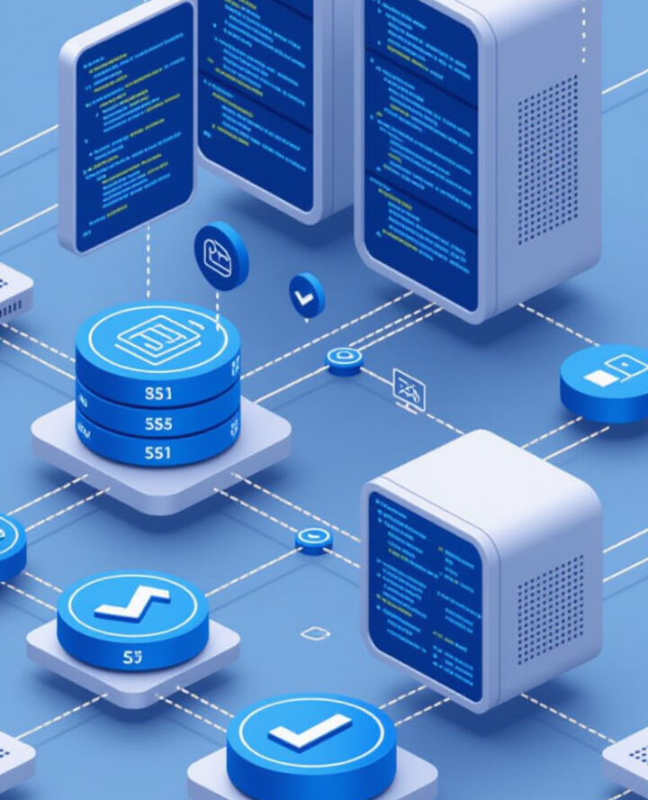
Docker Compose: Overview
docker-compose.yml is used to define and manage multi-container applications. It allows you to configure services, networks, and volumes.
Key Components:
Services: Define individual containers that make up your application.
Networks: Enable communication between containers, typically using a bridge network.
Volumes: Provide persistent storage across container restarts using named volumes.
Health Checks: Automatically monitor and report the health status of each service.

Slide 11
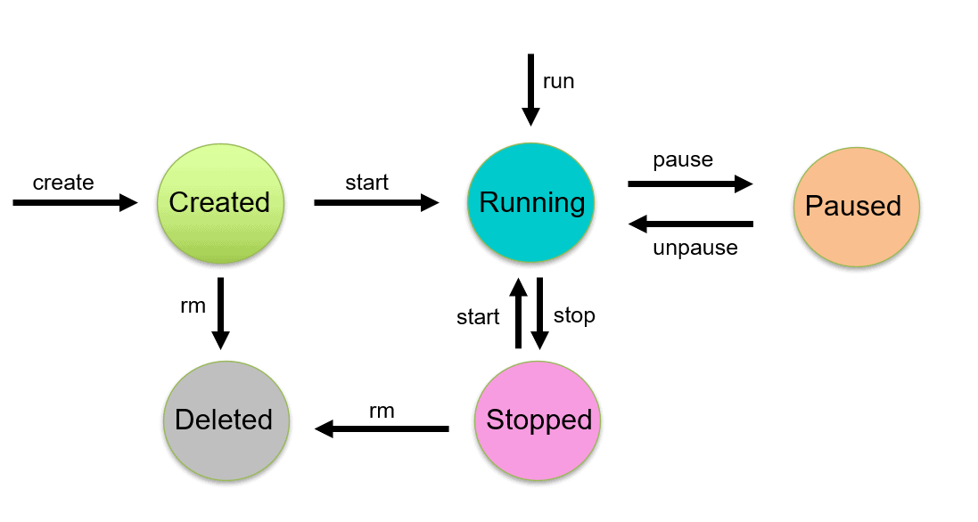
Container Lifecycle
Container Lifecycle & Image Cleanup
docker create – Creates a container from an image without starting it.
docker start – Starts a previously created or stopped container.
docker stop – Gracefully stops a running container.
docker rm – Removes a stopped container from the system.
Image Pruning
docker image prune – Deletes unused (dangling) images to free up disk space.
Helps maintain a clean environment and improves overall efficiency.

Slide 12
Best Practices for Docker
Efficient Docker Workflow: Best Practices
Use .dockerignore Exclude files and folders (e.g., .git, node_modules, logs) that shouldn't be in the image to speed up builds and reduce image size.
Keep Images Small Choose lightweight base images and install only essential dependencies.
Tag Versions Correctly Follow semantic versioning (e.g., v1.2.0) instead of using only latest for better tracking and rollback.
Minimize Layers Combine related commands (like RUN apt update && apt install) to reduce the number of layers and keep images lean.

